Slide 1
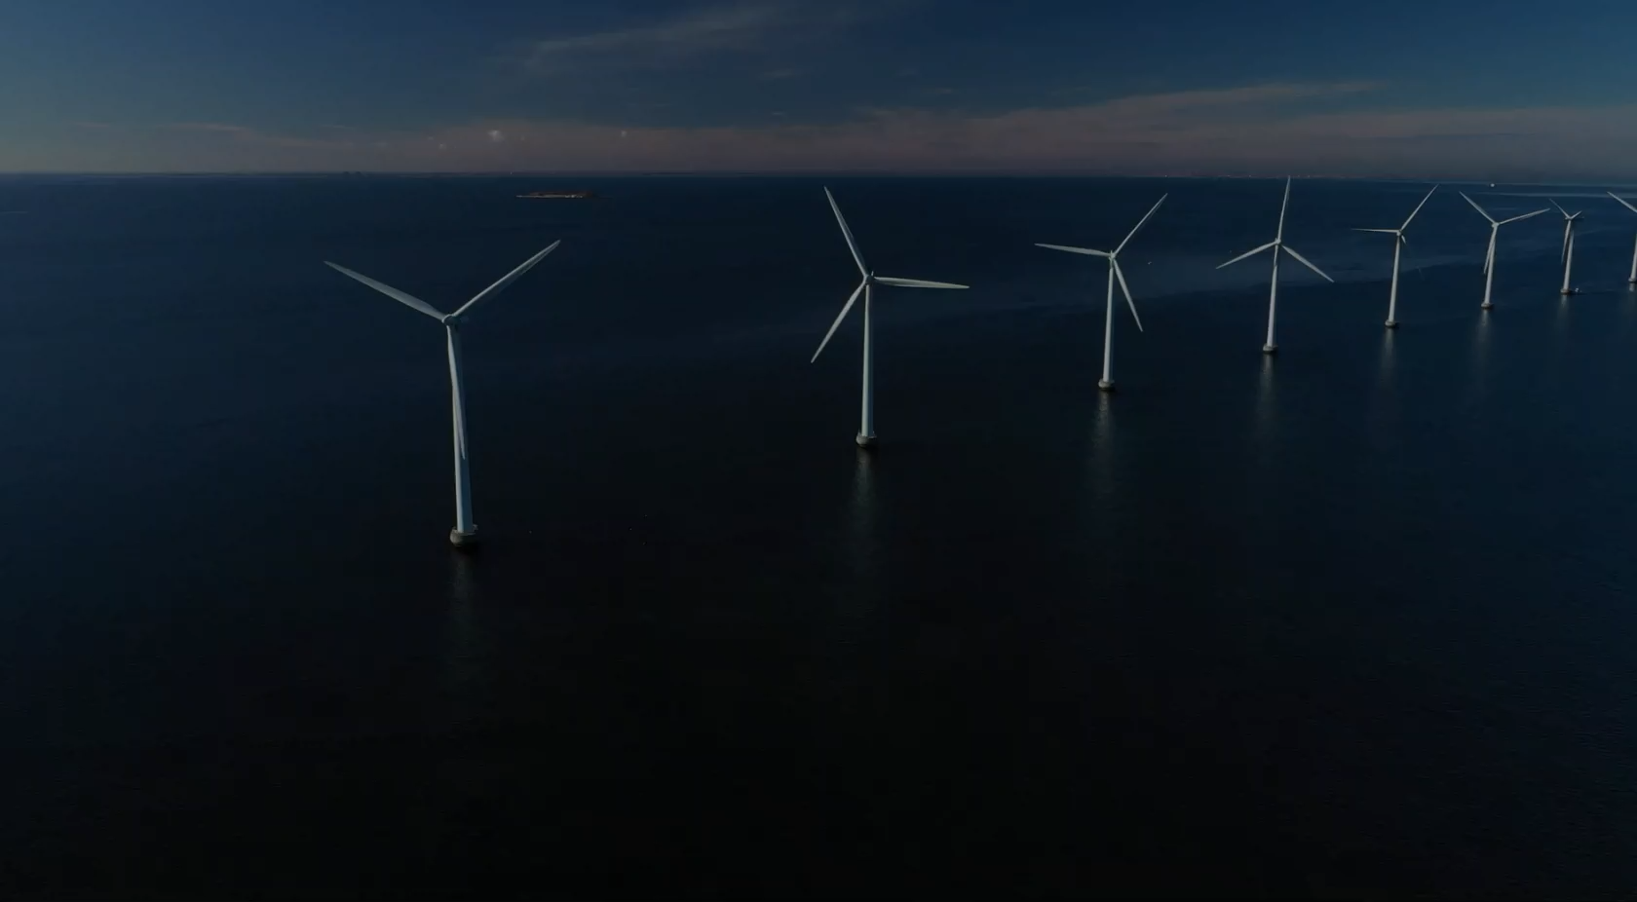


Passion for knowledge
– together for sustainability
NORCE is an independent research institute that conducts research for both public and private sectors, to facilitate informed and sustainable choices for the future.

Slide 2
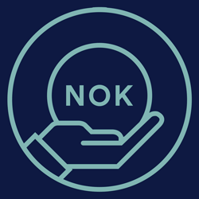



NORCE is an independent research institute that conducts research for both public and private sectors, to facilitate informed and sustainable choices for the future.
950
NOK mill.
750
employees
50
nationalities
75%
doctoral degrees

Slide 3
NORCE is an independent research institute that conducts research for both public and private sectors, to facilitate informed and sustainable choices for the future.
Locally grounded, with a global perspective
950
750
50
75%
NOK mill.
employees
nationalities
doctoral degrees
NORCE is Norway’s leading research institute with a presence along the entire Norwegian coast. Maintaining a strong local presence facilitates close collaboration with unique specialist communities, centres of expertise, the business community and government authorities.

Slide 4

Locally grounded, with a global perspective
NORCE is Norway’s leading research institute with a presence along the entire Norwegian coast. Maintaining a strong local presence facilitates close collaboration with unique specialist communities, centres of expertise, the business community and government authorities.
Priority areas
Our goal is to assist in solving major challenges for society, such as climate change, energy transition, the aging population, social inequality and youth exclusion.
To facilitate the creation of clear strategies for specific challenges, we have organised our interdisciplinary expertise into four areas of priority.
Notes:
NORCE is represented throughout Norway. Our large local presence enables close collaboration with unique centres of excellence, as well as the business community and public authorities. This is all beneficial to research.

Slide 5
Priority areas
Our goal is to assist in solving major challenges for society, such as climate change, energy transition, the aging population, social inequality and youth exclusion.
To facilitate the creation of clear strategies for specific challenges, we have organised our interdisciplinary expertise into four areas of priority.
1
Safe Communities
2
3
Sustainable Energy Production
Climate Challenges
4
Sustainable Oceans and Coasts

Slide 6

Priority areas
Our goal is to assist in solving major challenges for society, such as climate change, energy transition, the aging population, social inequality and youth exclusion.
To facilitate the creation of clear strategies for specific challenges, we have organised our interdisciplinary expertise into four areas of priority.
1
2
Safe and Inclusive Societies
Energy Future
3
4
Climate and Environmental Risk
Sustainable Oceans and Coasts
Notes:
Our goal is to help resolve major societal challenges such as sustainable development, climate, environment, economy and social inequalities. It requires focus to resolve such major challenges.
This is why we have pooled our expertise across subjects and organisation into four different focus areas so that we can more easily plan clear strategies around the specific challenges.

Slide 7
2
Sustainable Energy Production
1
3
4
Safe and
Inclusive Societies
Climate Challenges
Sustainable Oceans and Coasts
Research on security
and social sustainability in society.
2
Sustainable
Energy Production
Research on
future forms of energy.

Slide 8
1
Safe Communities
Research on security
and social sustainability in society.
2
Energy Future
Research on
future forms of energy.
3
Climate Challenges
Research on and modelling of climate change and climate risk.

Slide 9
2
Sustainable
Energy Production
Research on
future forms of energy.
3
Climate and Environmental Risk
Research on and modelling of climate change and climate risk.
4
Sustainable Oceans and Coasts
Research on the resources
in the fjords and ocean.

Slide 10
3
Climate Challenges
Research on and modelling of climate change and climate risk.
4
Sustainable Oceans and Coasts
Research on the resources
in the fjords and ocean.
Infrastructure
NORCE builds its own facilities and has access to a variety of infrastructure, including various labs and test facilities. This infrastructure is important for developing new knowledge that meets society’s needs, and contributes to a sustainable energy transition.

Slide 11
4
Sustainable Oceans and Coasts
Research on the resources
in the fjords and ocean.
Infrastructure
NORCE builds its own facilities and has access to a variety of infrastructure, including various labs and test facilities. This infrastructure is important for developing new knowledge that meets society’s needs, and contributes to a sustainable energy transition.
NORCE has the world’s most advanced and realistic drilling simulator environment

Slide 12
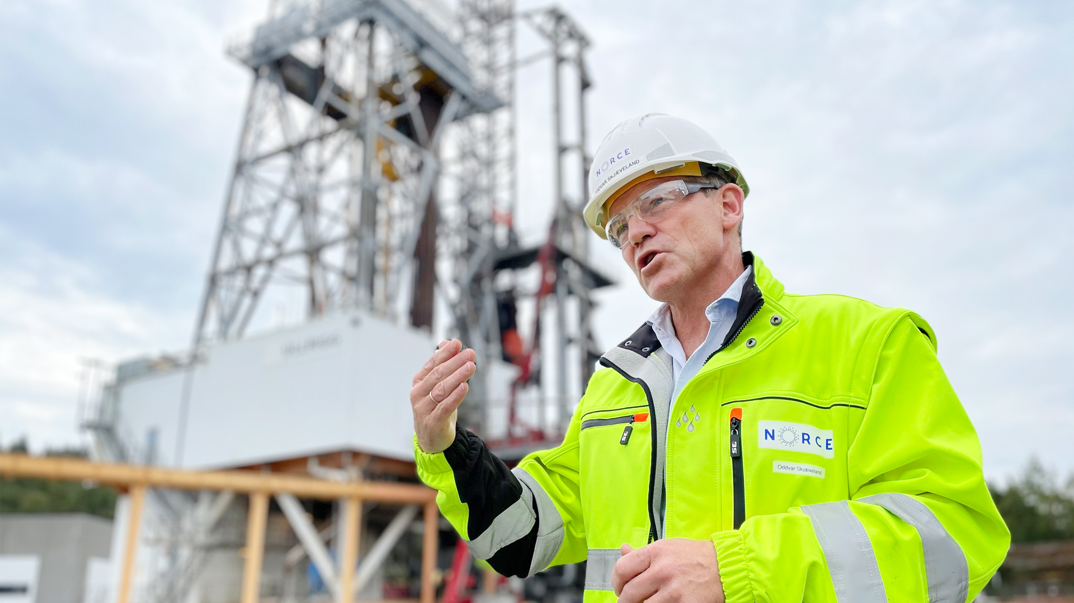






Drones used to monitor airports are equipped with autonomous sensor systems developed by NORCE
NORCE has the world’s most advanced and realistic drilling simulator environment
Why cooperate with NORCE
360-degree perspective
Independent research
Broad expertise
Extensive
experience
In-house infrastructure
Notes:
NORCE has the world's most advanced and realistic drilling simulator environment. It's called Ullrigg. Located in Stavanger, it is the world's most advanced full-scale test rig, contributing to the development and implementation of new drilling solutions, and reducing well costs on the Norwegian shelf.
“Imagine you're sitting on Ullrigg, a realistic environment with proper drilling machines. The drilling equipment will barely enter the well, but you’ll get a realistic response from the simulator that drills a virtual well, without necessarily conducting an actual drilling operation,” says operations manager at Ullrigg, Oddvar Skjæveland.
NORCE's vision of Ullrigg is to provide a world-leading drilling technology test laboratory. A location where everyone, locally, nationally and globally, can test their solutions.
Testing new solutions offshore is both time-consuming and expensive. At Ullrigg we connect the test rig to the simulator. Thus, there are advantages in being able to perform tests on land.
The goal is for engineers, scientists and users to be able to use the platform together to develop, test and qualify new technologies. This does not eliminate the need for testing offshore. But you can use the system for early-stage testing, trial and error, and weed out problems. This is ideal for demonstrating new technology and making it as ready as possible, in order to optimise on time spent offshore.
Ullrigg started in 1982 – in the early days of the Norwegian oil industry – as a drilling and well technology testing ground for a sector with significant needs from new actors in the industry.
By combining the physical machinery at Ullrigg with a virtual response from a simulator, the most advanced and realistic drilling simulator in the world has been developed.
The drilling rig has access to eight wells drilled into the ground at Ullandhaug.
According to requirements, Ullrigg is connected to a simulator, Open Lab, which collectively offers a unique test centre for new technology, new methods and new products. This is the most advanced and realistic drilling simulator in the world.
This is a high-tech arena which connects and combines the use of real, physical machines and a virtual response. This is unique in a drilling and well context.
The simulation environment OpenLab Drilling (simulator) at Ullandhaug at Ullrigg, which was completed with the support of the Research Council, is one of the pieces. The infrastructure is based on computational models for the simulation of realistic data from drilling operations and is readily available online. In OpenLab, the simulations can be done both in an online interface and in a physical simulator at NORCE and from Ullrigg.
The Ullrigg infrastructure is also highlighted as important in OG21 and the Research Council’s programme DEMO2000 in 2016 from Rystad Energy.
“As the leading, national research laboratory in drilling and well technology, Ullrigg plays an important role in efforts to increase recovery on the Norwegian shelf,” says the Rystad report.
This will be achieved through better well construction, new drilling techniques, faster, safer and less costly operations, better adaptation of technology and equipment to robust conditions, as well as new solutions to increase recovery rates”.
While we expect the Norwegian shelf to have several decades of production left, the shutdown of older production wells will also need to be planned. New methods of well plugging, which do not require large installations, will be able to save the Norwegian state significant costs. This will also facilitate the Norwegian supplier industry in an international market. The Ullrigg test facility is now being expanded with infrastructure in order to research and develop technology for the shutdown and abandonment of wells in the new Norwegian P&A Laboratories”.

Slide 13
Why cooperate with NORCE
Thank you.
Takk.
Merci.
Gracias.
Obrigado.
360-degree perspective
Independent research
Broad expertise
Extensive
experience
In-house infrastructure
norceresearch.no
@NORCEresearch
Notes:
Society is facing major challenges.
As an independent research institution with a 360-degree perspective, NORCE, as a multidisciplinary advisor, can give you the answers you need to make smart and sustainable choices for the future.

Slide 14
Thank you.
Takk.
Merci.
Gracias.
Obrigado.
norceresearch.no
@NORCEresearch

