Slide 1
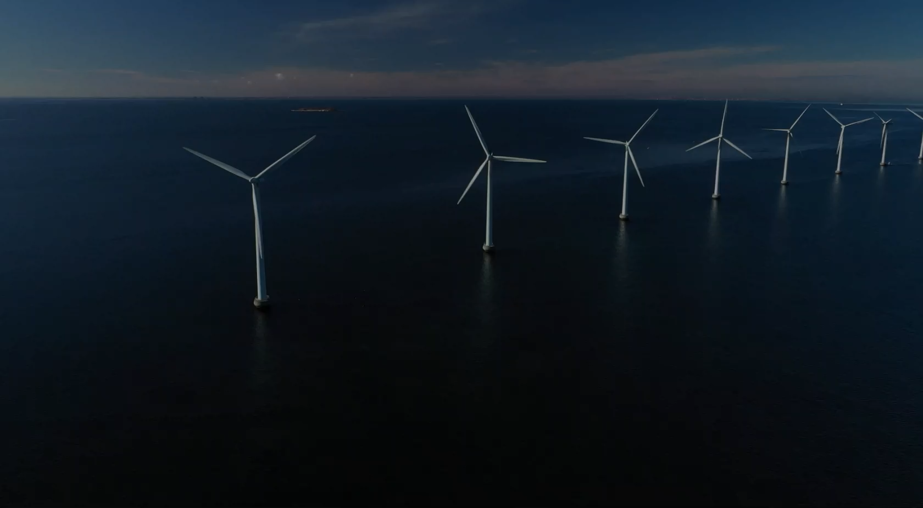


Passion for knowledge
– together for sustainability
NORCE is an independent research institute that conducts research for both public and private sectors, to facilitate informed and sustainable choices for the future.

Slide 2
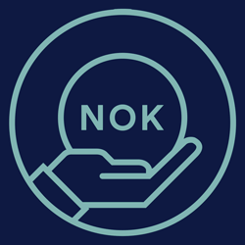



NORCE is an independent research institute that conducts research for both public and private sectors, to facilitate informed and sustainable choices for the future.
950
NOK mill.
750
employees
50
nationalities
75%
doctoral degrees

Slide 3
NORCE is an independent research institute that conducts research for both public and private sectors, to facilitate informed and sustainable choices for the future.
Locally grounded, with a global perspective
950
750
50
75%
NOK mill.
employees
nationalities
doctoral degrees
NORCE is Norway’s leading research institute with a presence along the entire Norwegian coast. Maintaining a strong local presence facilitates close collaboration with unique specialist communities, centres of expertise, the business community and government authorities.

Slide 4

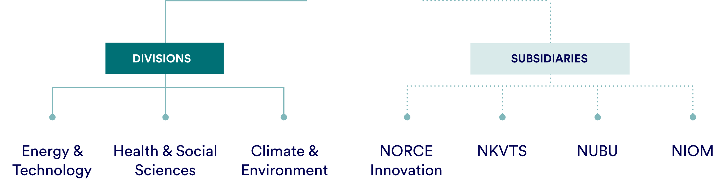
How we are organised
Locally grounded, with a global perspective
NORCE is Norway’s leading research institute with a presence along the entire Norwegian coast. Maintaining a strong local presence facilitates close collaboration with unique specialist communities, centres of expertise, the business community and government authorities.
Notes:
NORCE is represented throughout Norway. Our large local presence enables close collaboration with unique centres of excellence, as well as the business community and public authorities. This is all beneficial to research.

Slide 5
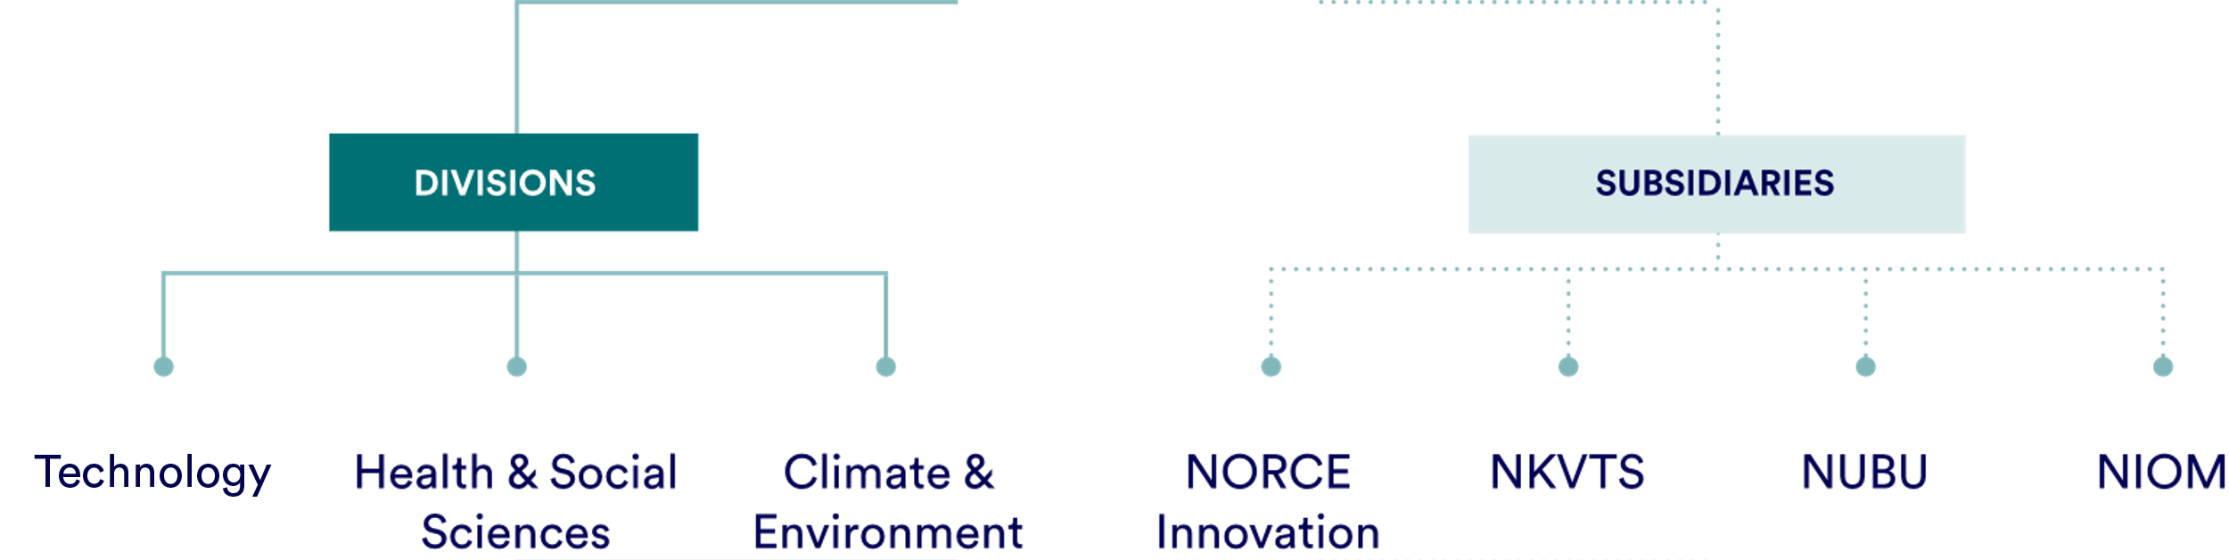
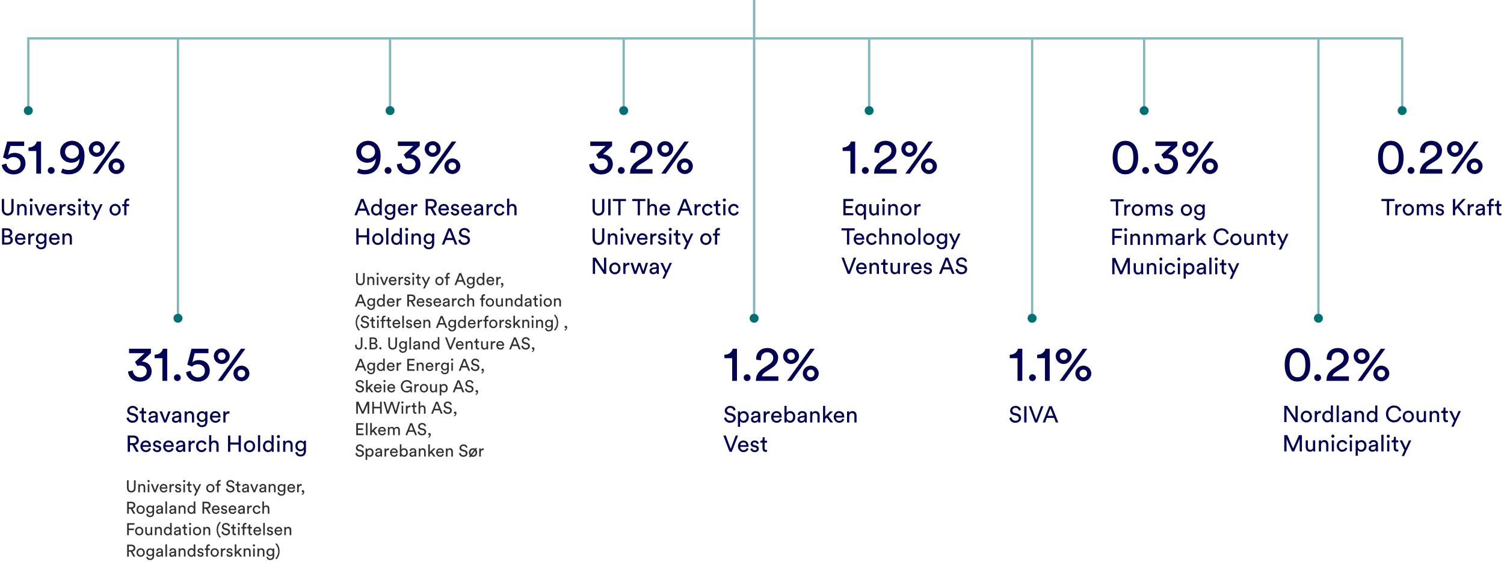
How we are organised
Shareholders

Slide 6

Shareholders
Priority areas
Our goal is to assist in solving major challenges for society, such as climate change, energy transition, the aging population, social inequality and youth exclusion.
To facilitate the creation of clear strategies for specific challenges, we have organised our interdisciplinary expertise into four areas of priority.

Slide 7
Shareholders
Priority areas
Our goal is to assist in solving major challenges for society, such as climate change, energy transition, the aging population, social inequality and youth exclusion.
To facilitate the creation of clear strategies for specific challenges, we have organised our interdisciplinary expertise into four areas of priority.
1
Safe Communities
2
3
Sustainable Energy Production
Climate Challenges
4
Sustainable Oceans and Coasts

Slide 8

Priority areas
Our goal is to assist in solving major challenges for society, such as climate change, energy transition, the aging population, social inequality and youth exclusion.
To facilitate the creation of clear strategies for specific challenges, we have organised our interdisciplinary expertise into four areas of priority.
1
2
Safe and Inclusive Societies
Energy Future
3
4
Climate and Environmental Risk
Sustainable Oceans and Coasts
Notes:
Our goal is to help resolve major societal challenges such as sustainable development, climate, environment, economy and social inequalities. It requires focus to resolve such major challenges.
This is why we have pooled our expertise across subjects and organisation into four different focus areas so that we can more easily plan clear strategies around the specific challenges.

Slide 9
Young people who are vulnerable to exclusion have a strong need for an adult who “sees” them
1
Safe and
Inclusive Societies
Research on security
and social sustainability in society.

Slide 10

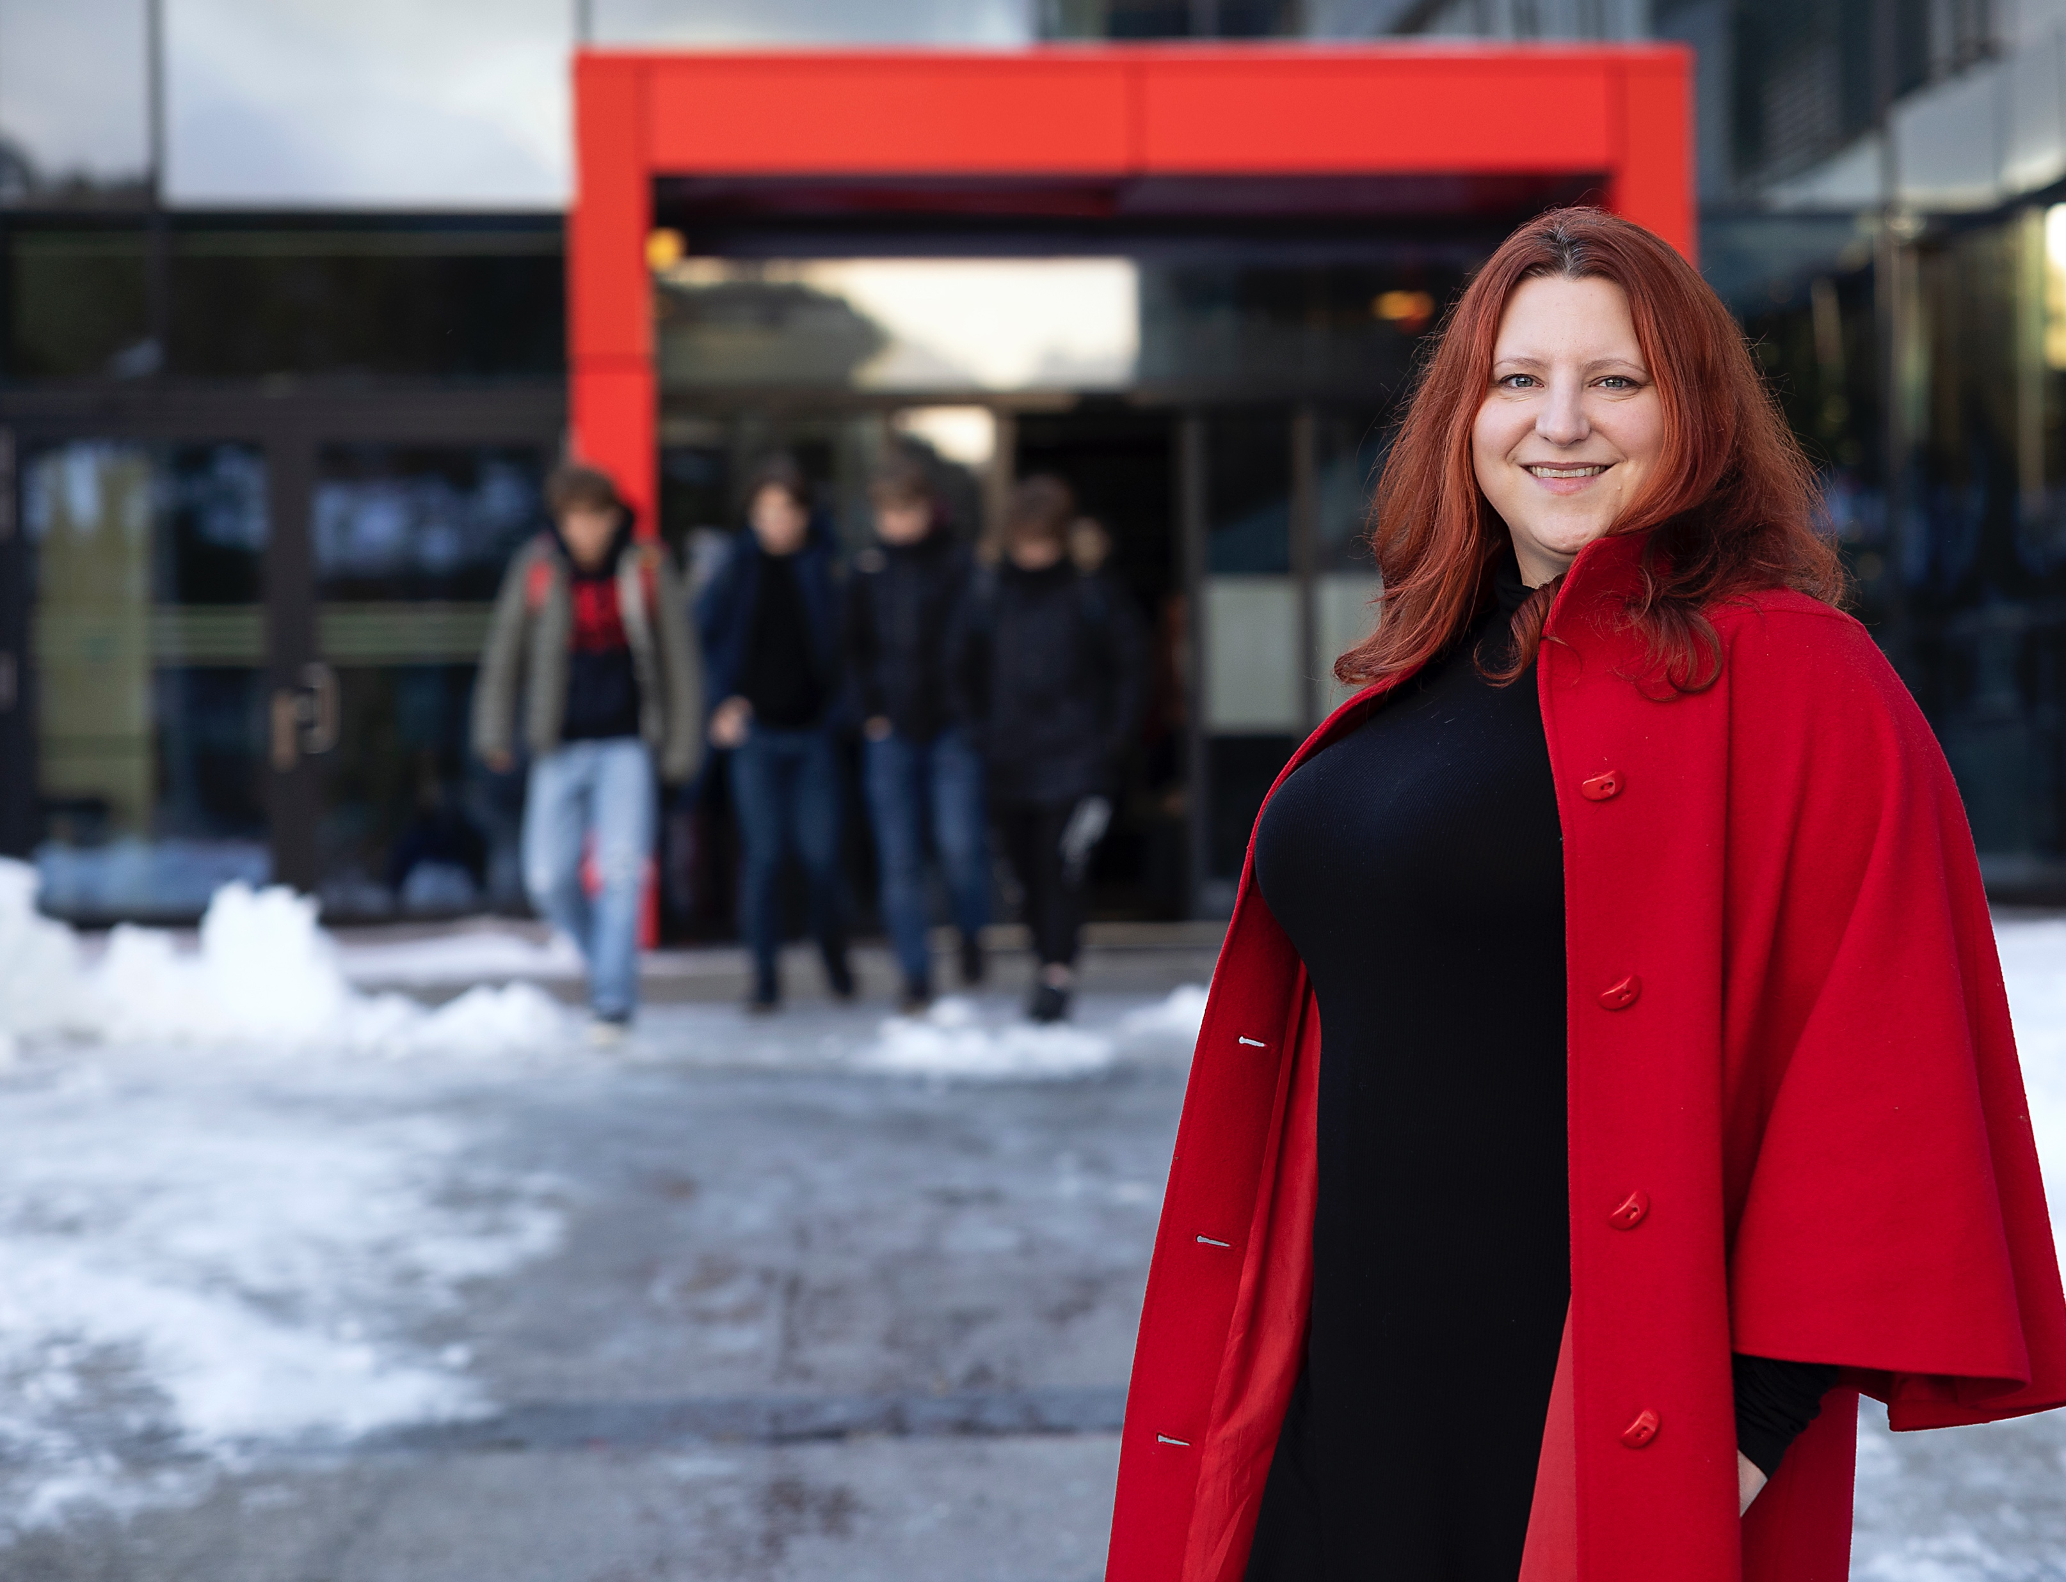
1
Safe and Inclusive Societies
Young people who are vulnerable to exclusion have a strong need for an adult who “sees” them
2
Sustainable
Energy Production
Research on
future forms of energy.
Notes:
NORCE has invested NOK one million in the internal project (KOS) Youth Exclusion in order to collect more information about this field. One of the associated projects has been conducted for the Norwegian Association of Local and Regional Authorities. Researcher Rebecca Lynn Radlick and her colleagues have examined 150 studies on young adults not in work or education.
The reports show that young people who fall through the cracks primarily need an attentive adult in their lives.
The reports also show that we don’t have as many young people who fall through the cracks as the rest of the OECD but that those who do are more deeply affected than the rest of the OECD. And the help they need is someone paying attention to them. NORCE is continuing to invest in this field and work closely with all relevant actors.
https://forskning.no/arbeid-barn-og-ungdom-skole-og-utdanning/unge-som-faller-fra-trenger-forst-og-fremst-en-voksen-som-ser-dem/1899544
https://www.ks.no/contentassets/25072fbf9d4d4577899c335e431117d7/Unge-utenfor-arbeid-opplering-og-utdanning.pdf

Slide 11
The energy of the future must not only be created, it must also be stored
2
Energy Future
Research for
sustainable energy solutions.

Slide 12
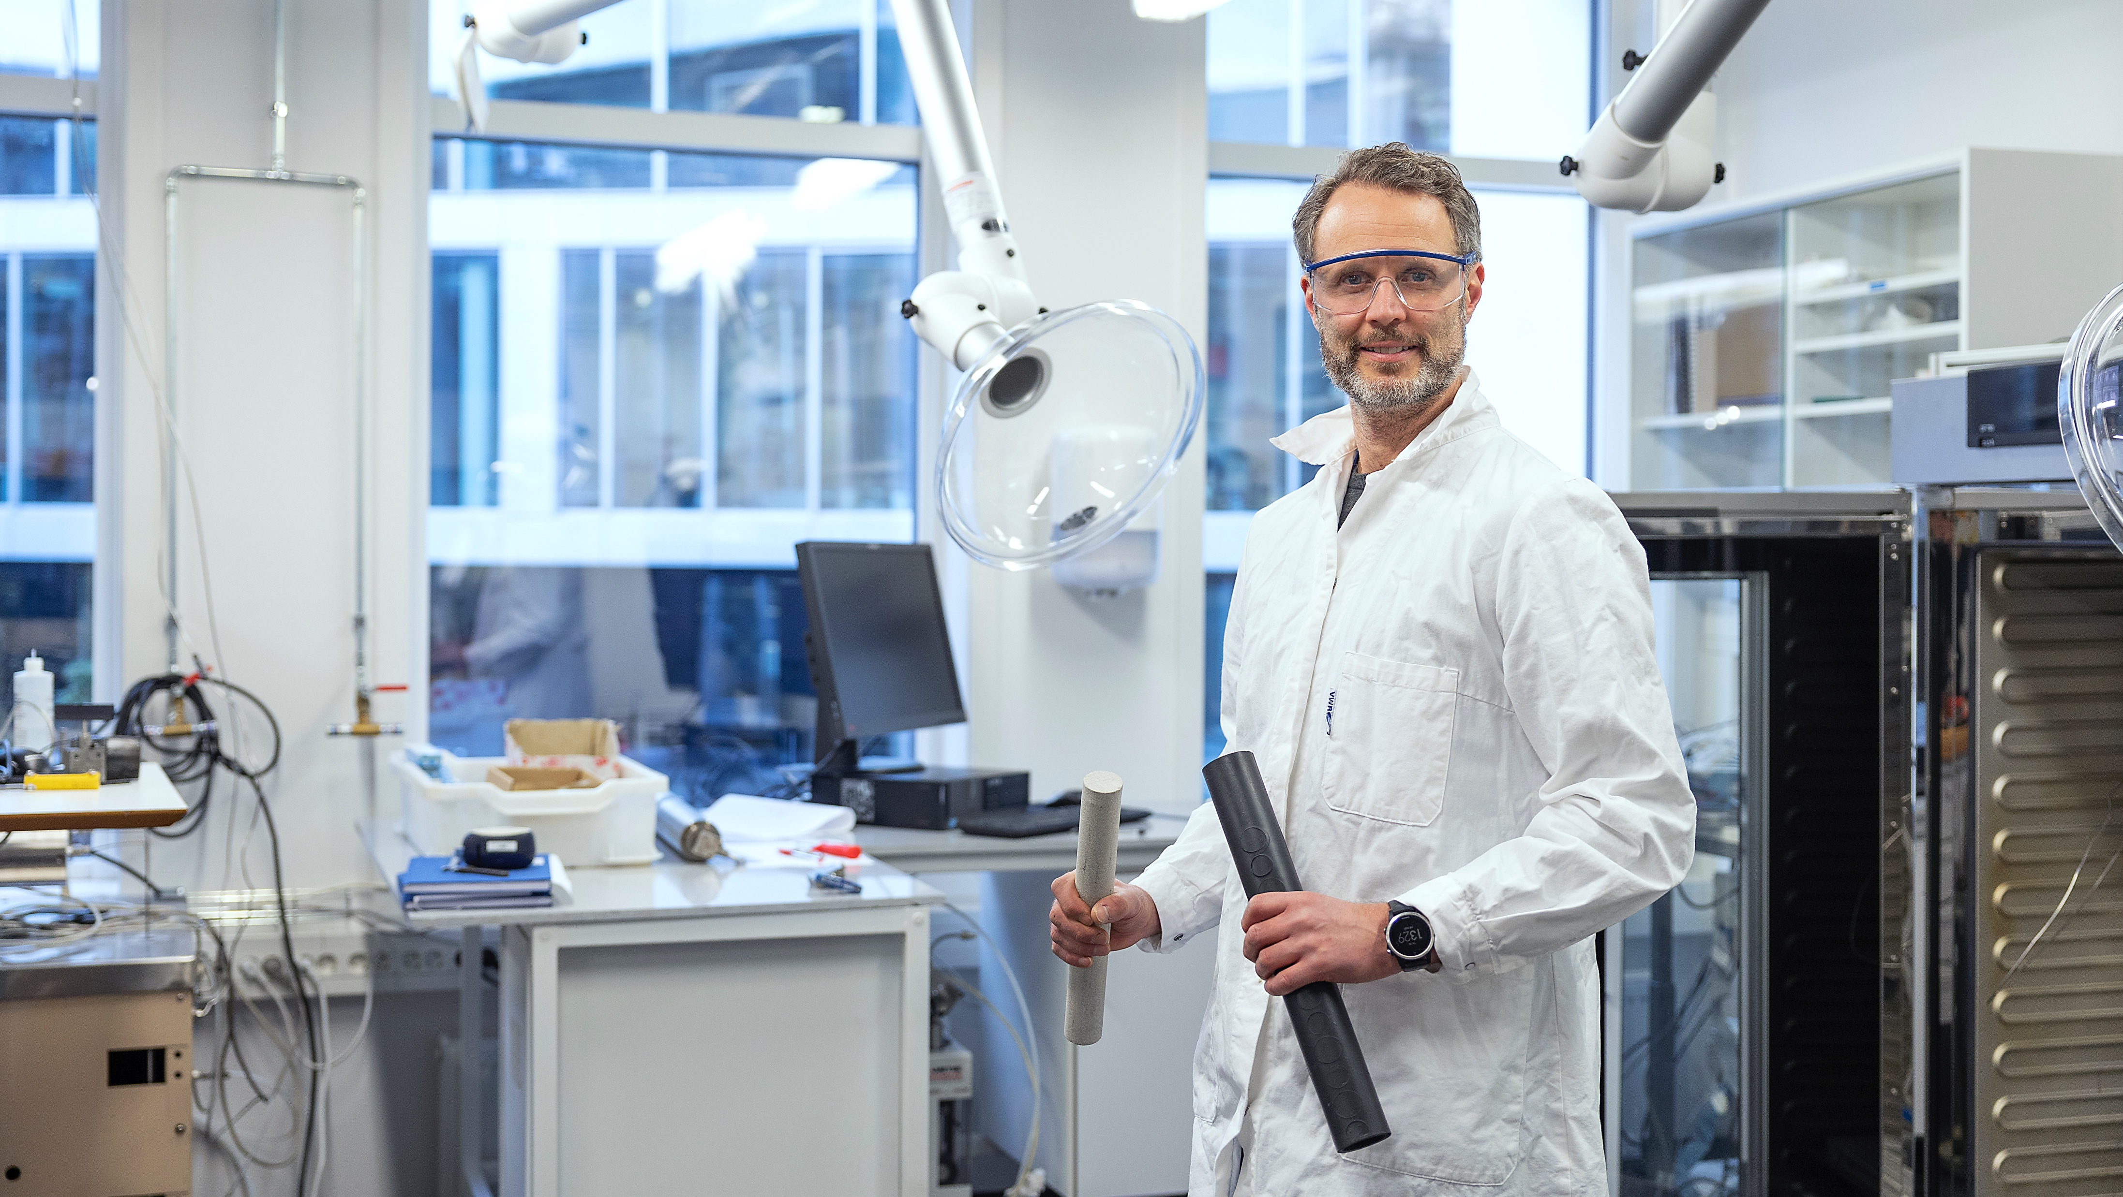
2
Energy Future
We must find ways to store the renewable energy for the future
3
Climate Challenges
Research on and modelling of climate change and climate risk.
Notes:
Renewable energy is the answer, but renewable energy such as hydrogen must not only be made, it must also be stored. We are on top of this research. Our old oil laboratory has been converted into a hydrogen laboratory.
Here, NORCE's research manager Ketil Djurhus uses his accumulated expertise from petroleum research to evaluate the possibilities of storing hydrogen which can, in turn, be made from water, gas, wind or sunlight.
We previously know that oil and gas are trapped in pockets of porous rock. Such knowledge is key as we are now investigating whether it is possible to store hydrogen in the old oil reservoirs out on the shelf.
And not just that. We're also aiming to make pure hydrogen out of natural gas from the North Sea – and without greenhouse gas ever coming up from the seabed. In the photo, Ketil holds a stone sample from the North Sea, where there are 25% air pockets in which CO2 and hydrogen can be stored.

Slide 13
Seasonal forecasts that help farmers secure feed for their sheep
3
Climate and Environmental Risk
Research on and modelling of climate change and climate risk.

Slide 14
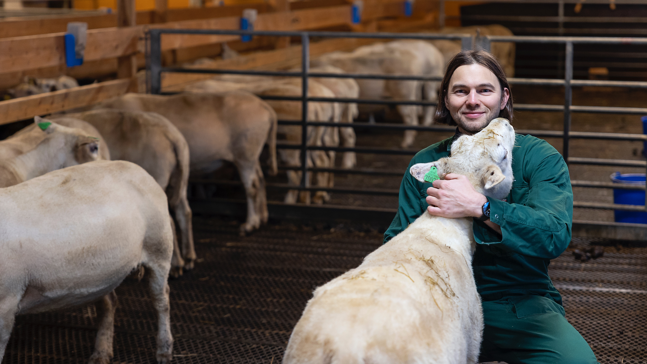
3
Climate and Environmental Risk
Seasonal forecasts that help farmers secure feed for their sheep
4
Sustainable Oceans and Coasts
Research on the resources
in the fjords and ocean.
Notes:
The sheep in the barn at Stend Upper Secondary school in Bergen are the Norwegian white sheep breed. They receive silo feed and grain feed during the winter, but spend the summer outdoors, where they depend on good summers and plenty of grass.
Feed access is one of the focus areas at which Manuel Hempel at NORCE’s Centre for research-driven innovation, Climate Futures is looking. The centre, comprising seven research partners and close to 30 user partners, helps climate and weather prone sectors by building warnings based on five warning models, each of which gives 30 scenarios.
Manuel Hempel works in the agricultural node. He will be taking a PhD in the field of social geography and is examining how climate warnings from 10 days to 10 years ahead can be incorporated in decision-making processes and contribute to a reduction in climate-related losses. We have focus groups comprising public sector actors, business enterprises and farmers from Tysnes, Hardanger, Trøndelag and Kongsvinger, among other places.
klimavarsling.no – Prognoser fra Climate Futures

Slide 15
4
How to make fish more appealing as a culinary choice
Sustainable Oceans and Coasts
Research on the resources
in the fjords and ocean.

Slide 16
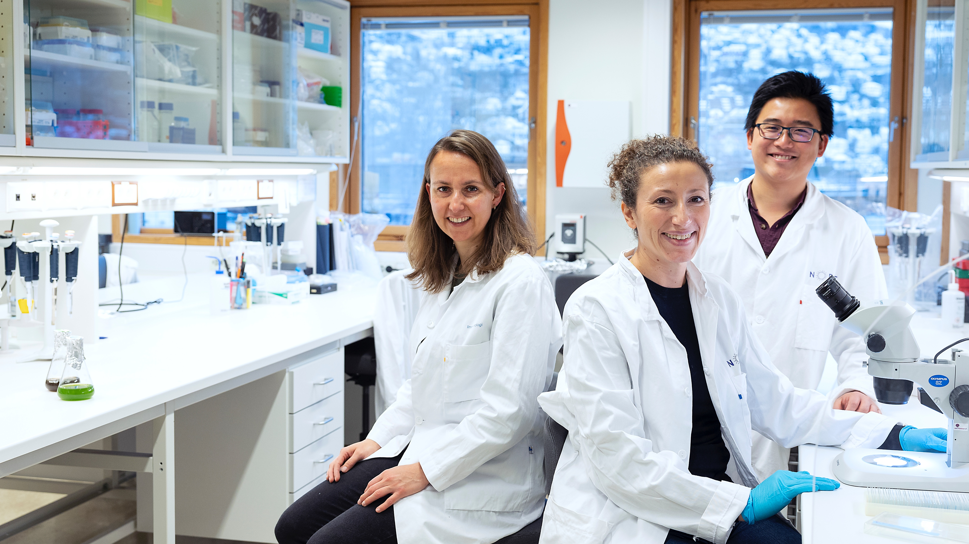
4
Sustainable Oceans and Coasts
How to make fish even more useful
Notes:
Fish aquaculture is essential for providing healthy food to a growing global population, but its success depends on our ability to identify more sustainable farming practices. In this respect, the EU horizon project iFishIENCi will help.
The aim of iFishienci is to develop and demonstrate cutting-edge IoT/AI-based innovations, while taking into account the feed value chain as a whole.
We are simply building more effective ways to monitor fish health and welfare, as well as more effective ways to feed fish. We will also reduce the pressure on the source of fish feeding ingredients, such as agricultural crops and wild fish that are used in fishmeal and oil.
The photo shows Norce researchers Dorinde Kleinegris, Naouel Gharbi and I-Hao Chen.
Ifishienci is funded by the EU. 16 partners are participating in an interdisciplinary collaboration to create global improvements in fish farming.
The Project - iFishienci

Slide 17
Infrastructure
NORCE builds its own facilities and has access to a variety of infrastructure, including various labs and test facilities. This infrastructure is important for developing new knowledge that meets society’s needs, and contributes to a sustainable energy transition.
Drones used to monitor airports are equipped with autonomous sensor systems developed by NORCE

Slide 18
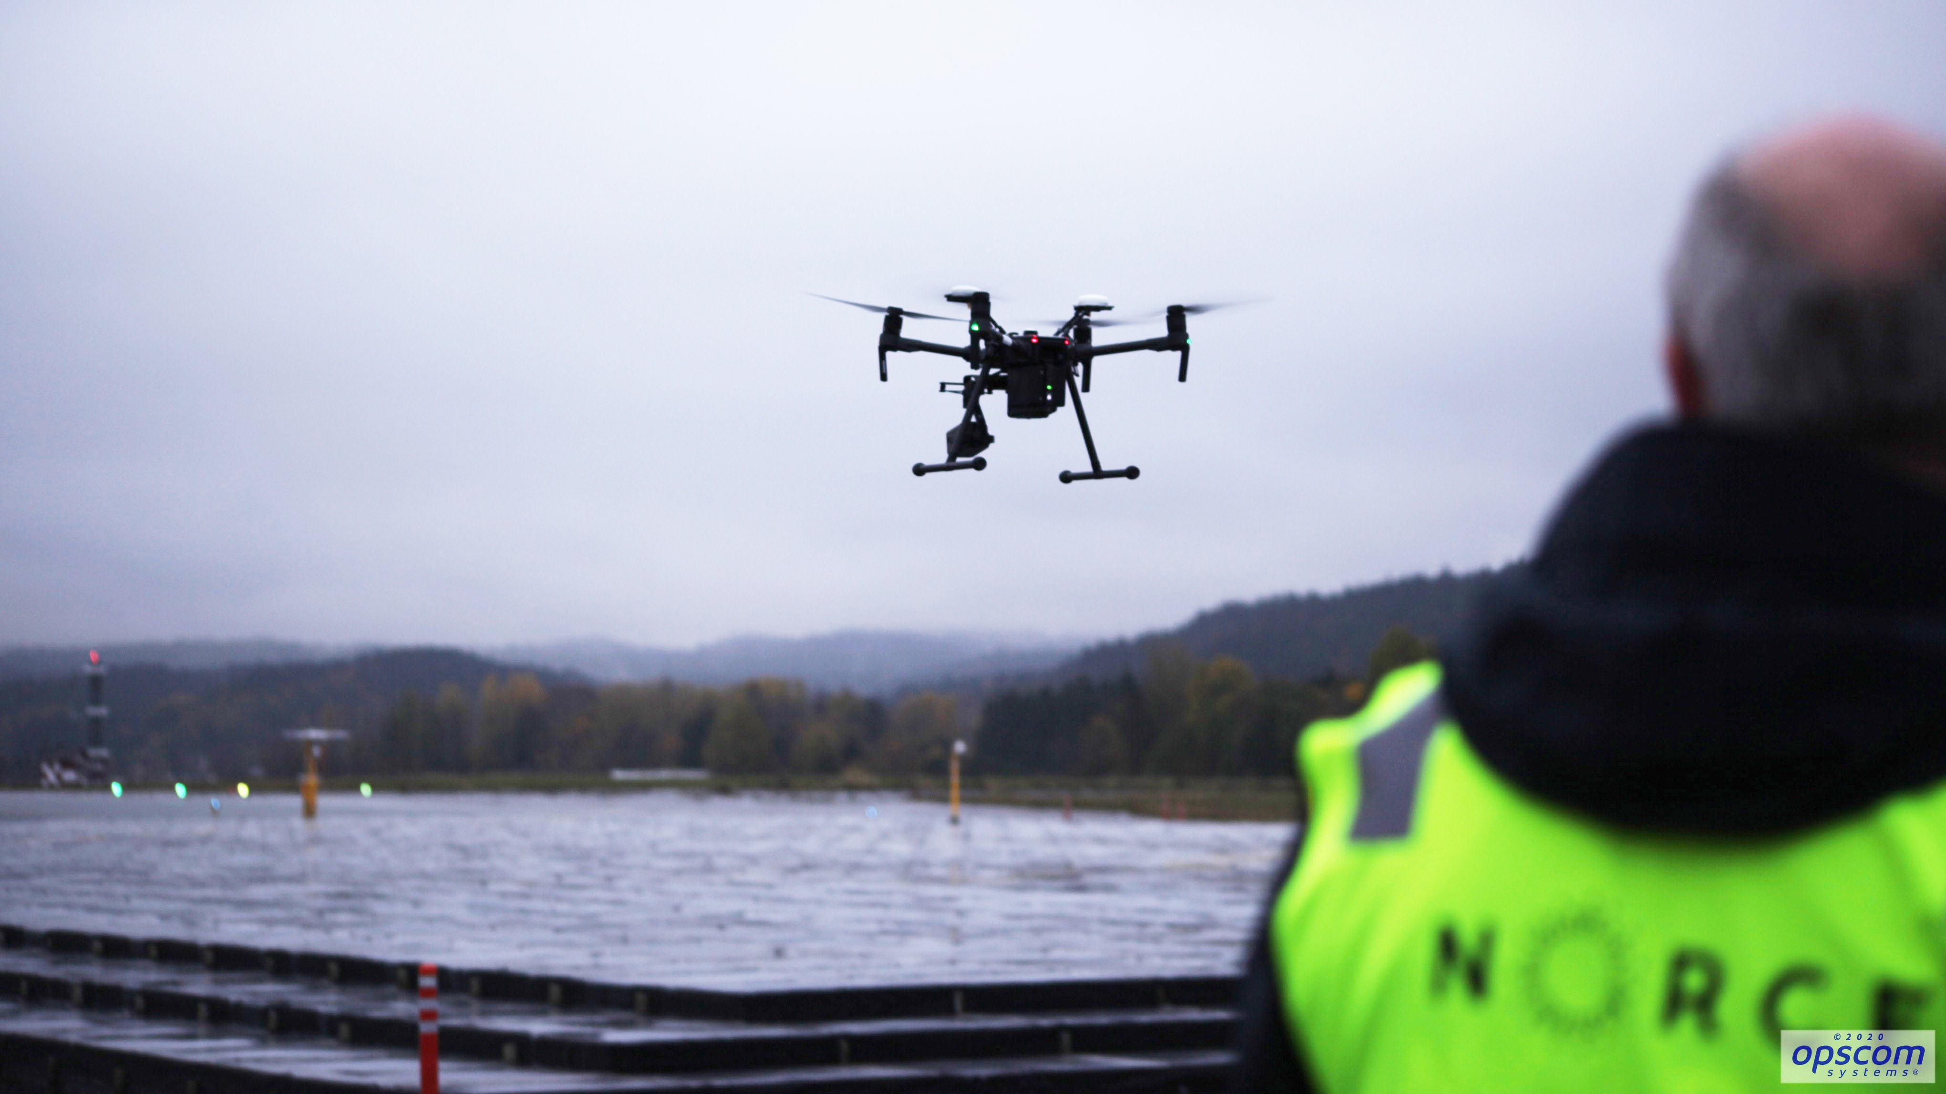
Drones used to monitor airports are equipped with autonomous sensor systems developed by NORCE
NORCE has the world’s most advanced and realistic drilling simulator environment
Notes:
Thus far, flying drones have not been welcome at either Norwegian or other European airports. This project is creating the conditions to change precisely that.
The goal of the project, which examines autonomous sensor systems, is to achieve more efficient airport operations through reduced requirements for manual inspection of security-critical areas and equipment at the airport.
A groundbreaking three-year collaboration project between NORCE, Opscom Systems and AVINOR, integrating inspections with drones and automatic sensor systems, into the day-to-day operations of airports.
Opscom Systems is the administrative manager and owner of the project, while NORCE is a research partner.
The project will show the value of new digital solutions – and is already considering how these can be used in regular airport operations. Opscom Systems, together with NORCE, will develop new digital solutions that analyse the images and identify errors or deficiencies on the object digitally and geo-referenced in a database, and generates work orders directly into the airport's operating and security management system.

Slide 19
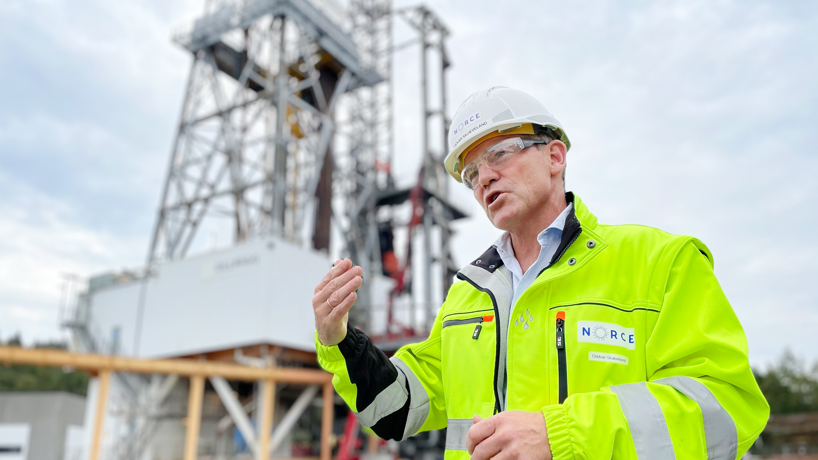






Drones used to monitor airports are equipped with autonomous sensor systems developed by NORCE
NORCE has the world’s most advanced and realistic drilling simulator environment
Why cooperate with NORCE
360-degree perspective
Independent research
Broad expertise
Extensive
experience
In-house infrastructure
Notes:
NORCE has the world's most advanced and realistic drilling simulator environment. It's called Ullrigg. Located in Stavanger, it is the world's most advanced full-scale test rig, contributing to the development and implementation of new drilling solutions, and reducing well costs on the Norwegian shelf.
“Imagine you're sitting on Ullrigg, a realistic environment with proper drilling machines. The drilling equipment will barely enter the well, but you’ll get a realistic response from the simulator that drills a virtual well, without necessarily conducting an actual drilling operation,” says operations manager at Ullrigg, Oddvar Skjæveland.
NORCE's vision of Ullrigg is to provide a world-leading drilling technology test laboratory. A location where everyone, locally, nationally and globally, can test their solutions.
Testing new solutions offshore is both time-consuming and expensive. At Ullrigg we connect the test rig to the simulator. Thus, there are advantages in being able to perform tests on land.
The goal is for engineers, scientists and users to be able to use the platform together to develop, test and qualify new technologies. This does not eliminate the need for testing offshore. But you can use the system for early-stage testing, trial and error, and weed out problems. This is ideal for demonstrating new technology and making it as ready as possible, in order to optimise on time spent offshore.
Ullrigg started in 1982 – in the early days of the Norwegian oil industry – as a drilling and well technology testing ground for a sector with significant needs from new actors in the industry.
By combining the physical machinery at Ullrigg with a virtual response from a simulator, the most advanced and realistic drilling simulator in the world has been developed.
The drilling rig has access to eight wells drilled into the ground at Ullandhaug.
According to requirements, Ullrigg is connected to a simulator, Open Lab, which collectively offers a unique test centre for new technology, new methods and new products. This is the most advanced and realistic drilling simulator in the world.
This is a high-tech arena which connects and combines the use of real, physical machines and a virtual response. This is unique in a drilling and well context.
The simulation environment OpenLab Drilling (simulator) at Ullandhaug at Ullrigg, which was completed with the support of the Research Council, is one of the pieces. The infrastructure is based on computational models for the simulation of realistic data from drilling operations and is readily available online. In OpenLab, the simulations can be done both in an online interface and in a physical simulator at NORCE and from Ullrigg.
The Ullrigg infrastructure is also highlighted as important in OG21 and the Research Council’s programme DEMO2000 in 2016 from Rystad Energy.
“As the leading, national research laboratory in drilling and well technology, Ullrigg plays an important role in efforts to increase recovery on the Norwegian shelf,” says the Rystad report.
This will be achieved through better well construction, new drilling techniques, faster, safer and less costly operations, better adaptation of technology and equipment to robust conditions, as well as new solutions to increase recovery rates”.
While we expect the Norwegian shelf to have several decades of production left, the shutdown of older production wells will also need to be planned. New methods of well plugging, which do not require large installations, will be able to save the Norwegian state significant costs. This will also facilitate the Norwegian supplier industry in an international market. The Ullrigg test facility is now being expanded with infrastructure in order to research and develop technology for the shutdown and abandonment of wells in the new Norwegian P&A Laboratories”.

Slide 20
Why cooperate with NORCE
Thank you.
Takk.
Merci.
Gracias.
Obrigado.
360-degree perspective
Independent research
Broad expertise
Extensive
experience
In-house infrastructure
norceresearch.no
@NORCEresearch
Notes:
Society is facing major challenges.
As an independent research institution with a 360-degree perspective, NORCE, as a multidisciplinary advisor, can give you the answers you need to make smart and sustainable choices for the future.

Slide 21
Thank you.
Takk.
Merci.
Gracias.
Obrigado.
norceresearch.no
@NORCEresearch

